Slide 1

PHISHING AWARENESS
Phishing Awareness Training
Presented by: [Kavya.N], Cybersecurity Intern-CodeAlpa

Slide 2
INTRODUCTION TO
PHISHING
  Phishing is a cyber attack where attackers impersonate trusted entities.
  The goal is to steal sensitive information such as:
  Login credentials
  Banking details
  Personal information
  Phishing attacks mainly target human trust rather than systems.

Slide 3

Types of Phishing Attacks
Email Phishing
SMS Phishing
Fake emails appear legitimate and trick recipients into providing sensitive information like passwords or credit card numbers.
Fraudulent text messages contain malicious links, encouraging users to click and reveal personal or financial details.
Voice Phishing
Fake Websites
Phone calls impersonate trusted organizations, manipulating victims into sharing private information through urgency or threats.
Copycat sites mimic legitimate ones, designed to harvest user data by luring victims into entering personal information.

Slide 4
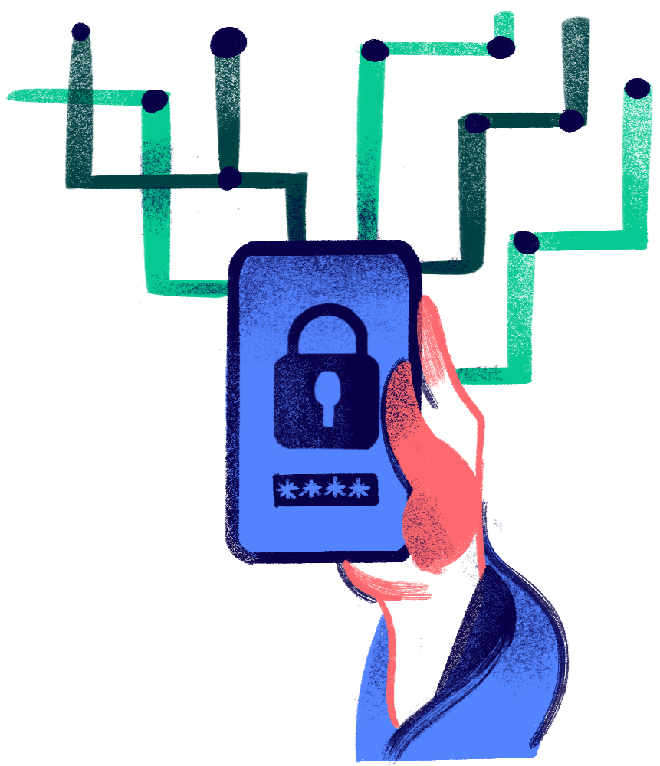
Characteristics of
Phishing Emails
  Creates urgency or fear
  Requests immediate action
  Contains suspicious links or attachments
  Often includes spelling or grammar mistakes
Example:
“Your account will be suspended. Verify immediately.”

Slide 5
Social Engineering Techniques
Urgency
Trust
Rewards
Attackers create a sense of urgency to compel quick decisions and bypass critical thinking.
They often pretend to be someone you trust, like a colleague or bank representative, to manipulate you.
Many phishing attempts offer rewards or threaten consequences to elicit immediate responses from potential victims.

Slide 6
Identifying Phishing Emails
  Verify sender email addresses
  Hover over links before clicking
  Avoid sharing OTPs or passwords
  Check website URLs carefully
  Confirm messages through official channels

Slide 7
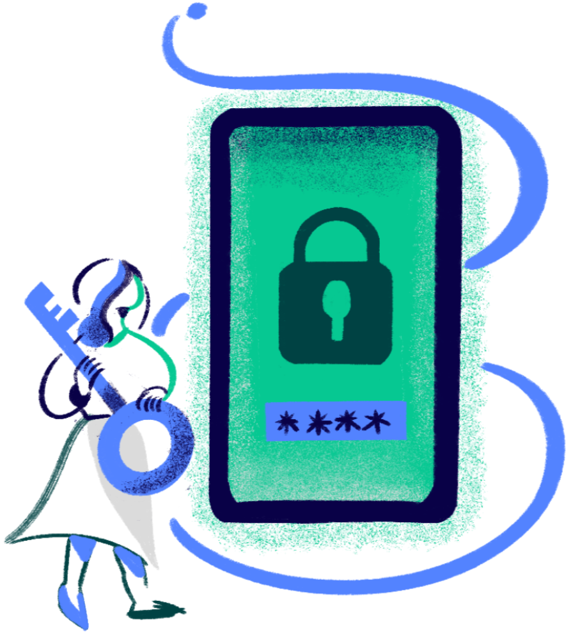
Fake Website Indicators
  Slightly modified URLs
  Missing HTTPS security
  Poor design or broken pages
  Requests for sensitive information
Example:
Legitimate: www.amazon.com
Fake: www.amazon-login-support.net

Slide 8
Best Practices for Protection
Update Software
Strong Passwords
Two-Factor Authentication
Patches vulnerabilities, fixes bugs, and strengthens defenses against evolving cyber threats .
Combine uppercase, lowercase, numbers, and symbols to create unique, hard-to-guess passwords .
Adds an extra layer of security by requiring a second form of verification, like a code sent to your phone, in addition to your password .
Think Before Clicking
Report Suspicious Emails
Pause and verify the sender, link, or attachment before clicking to avoid phishing scams, malware, or other cyber threats .
Forward suspicious emails to the IT team or mark as spam to protect yourself and others from phishing attempts .

Slide 9
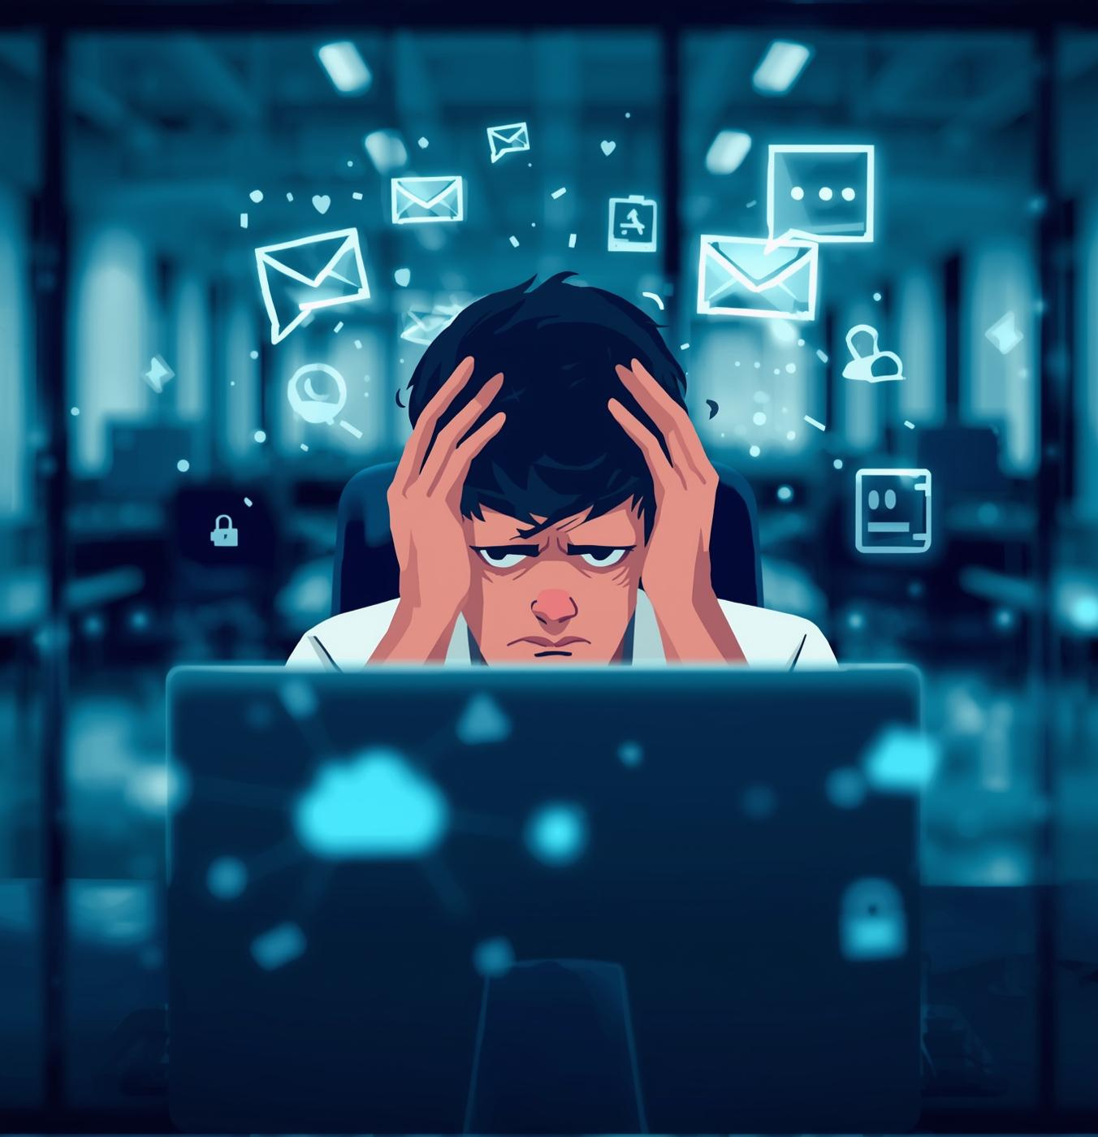
Real-World Impact
  Users received fake bank messages
  Redirected to fraudulent websites
  Login credentials were stolen
  Financial loss occurred
Lesson:
Always verify before responding to urgent messages.

Slide 10
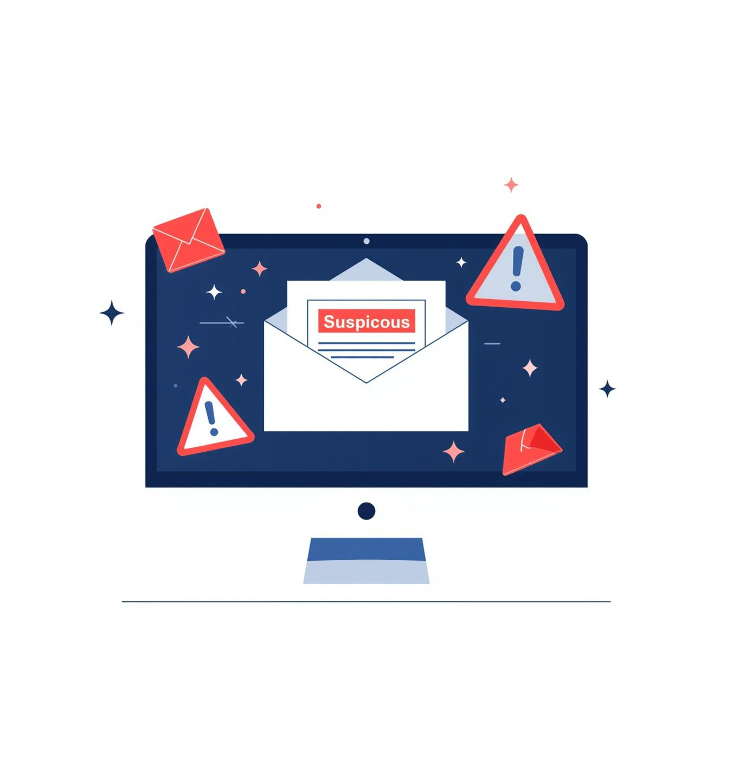
Phishing Awareness Quiz
You receive an email asking for OTP to “secure your account.”
Is this safe?
Answer:
No — This is a phishing attempt

Slide 11

Conclusion
  Phishing attacks exploit human behavior
  Awareness is the strongest defense
  Always think before clicking or sharing information
  Cyber security starts with informed users

